Slide 1



Evidence-based Strategies
Preventing and Reducing Stigma
August 18, 2021
9:00 AM -12:00 P.M. EST
Chuck Klevgaard
Prevention Manager
Great Lakes PTTC
Prevention Insights
School of Public Health at Indiana University
MI
Notes:
Welcome to this recorded webinar on Preventing and Reducing Stigma
You may be listening today simply to increase your understanding of stigma and how to reduce it, others of you may be listening as trainers or community mobilizers to prepare yourselves to take action that include making presentations of your own
For those of you who are trainers, keep know that the slides you are about to see can be downloaded and customized for your own use.
As you can see on this title, you can add your local organization or town, and who is presenting
In addition, you will find slide sets focused on individual community sectors or types of professionals such as criminal justice or prevention specialists
We are so glad you joined us to learn about this important topic.
The Role for Prevention in the Prevention and Reduction of Stigma
December 8, 10:00-11:30 a.m.
Stigma disproportionately influences health outcomes and mental well-being for individuals with mental health or substance use disorder (SUD). Fear of being judged and/or discriminated against can prevent people from getting the help they need. As prevention practitioners, we are in a unique position to reduce the stigma surrounding substance misuse. The language we use to discuss substance use disorders (SUDs) either formally, as part of prevention messaging, or informally, in conversations with colleagues and stakeholders, can either increase or decrease SUD stigma.
Objectives
Describe three levels of stigma
Articulate the importance of non-stigmatizing language
List evidence-based strategies for stigma prevention or reduction
Timeline:
November 23: Materials to Mel
December 3: Materials to Shannon
December 4: Tech run through
December 7: Materials to state
December 8: Webinar

Slide 2






Which Pictures Depict Your Work Currently?
Write the number(s) in the chat
1
2
3
4
5
6
Select view options, select annotate, and then select a stamp

Slide 3
Learning Objectives
By the end of the training, participants will be able to:
Define stigma and describe common components of stigma
Discuss the multidimensional, multi-level concept of stigma
Understand the impact of stigma and the barriers it can create for individuals
Describe the importance of non-stigmatizing language
List cross-cutting practices for preventing or reducing stigma
Understand the role of prevention professionals and coalitions to reduce and prevent stigma
Create a local plan for stigma prevention or reduction
Notes:
Okay Lets get started, as a result of listening to this recorded webinar today you will be able to
Describe common components and three levels of stigma
Describe the importance of non-stigmatizing language
List cross-cutting practices for preventing or reducing stigma
List evidence-based strategies for stigma prevention or reduction

Slide 4

Agenda
Presentation: Preventing & Reducing Stigma
  Breakout 1
  Report Out and Debrief
Presentation: Roles For Prevention & Working Across Sectors
  Breakout 2
  Report Out and Debrief
Presentation on Creating a Plan
Virtual Tour of Great Lakes PTTC Site
Questions

Slide 5




A Basic Definition
“Stigma can be understood as an attribute, behavior, or reputation that is socially discrediting, and substance-related problems appear to be particularly susceptible to stigma.”
(John F. Kelly∗, Cassandra M. Westerhoff)
Notes:
Its important to clarify what we are talking about. We encourage everybody to take the time to introduce a basic definition.
This can create stimulate conversation, provide a foundation for common language, and increase community-wide literacy on this topic of stigma.
This definition comes to us from John Kelly and Casandra westerhoff, two important researchers in the field and major contributors to our current understanding of the importance of language. You will hear more about that later in this recoding.
So a basic definition states:
“Stigma can be understood as an attribute, behavior, or reputation that is socially discrediting, and substance-related problems appear to be particularly susceptible to stigma.”
Now take a minute to assess how this definition squares with your own beliefs
Tip: Invite people to react to this definition. In particular, please comment on the language in this definition that squares with what you believe.

Slide 6
A Look at the Components of Stigma
Stereotypes
Ideas
Discrimination Actions
Prejudice
Beliefs
Notes:
Lets now look at stigma as components
Stereotypes: Ideas and attitudes assigned to labeled social entities
Prejudice: Endorsement of negative beliefs and attitudes within those stereotypes
Discrimination Behaviors that act to endorse and reinforce stereotypes, and disadvantage those labeled
Stigma is frequently conferred through labels, which are at times officially sanctioned terms encoded by official agents of (e.g., “mentally ill” by the medical profession, “criminal” by the justice system) intentional or not this perpetuates negative beliefs.
It also happens informally (e.g., anyone referring to an entire race of individua's as “lazy”) sets up the negative belief and leading to prejudice.
To be clear labels produce stereotypes with variable levels of negative social consequences of prejudice often leading to discrimination
The word stigma itself is sometimes debated, some see it as “a victim word, and prefer “discrimination as a better word for framing the issue”
While I would agree that its important that all of us play a role in shaping perceptions, I think its also important to bring people together, meaning don’t get hung up about political correctness. Instead focus on where you and a colleague can agree. Be gentle with folks who use stigmatizing language, its almost always unintentional. A gentle reminder about language in private is always more productive than a public reprimand.

Slide 7
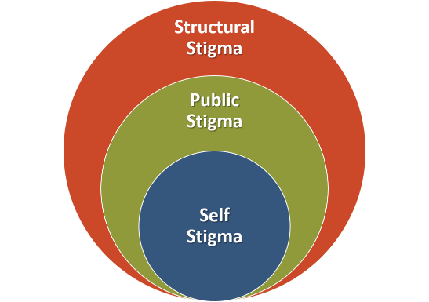
Stigma on Three Levels
Stigma is a dynamic multidimensional, multilevel phenomenon that occurs at three levels of society—structural (laws, regulations, policies), public (attitudes, beliefs, and behaviors of individuals and groups), and self-stigma (internalized negative stereotypes).
(National Academies Press, 2016)
Notes:
Stigma happens on various levels or sometimes described as layers in somewhat of an ecological model
Structural Stigma: Prejudice and discrimination by policies, laws, and constitutional practice; also called institutionalized stigma at the societal level or community level
Public Stigma: Stereotypes, prejudice, and discrimination endorsed by the general population a set of negative attitudes and beliefs that motivate individuals to fear, reject, avoid, and discriminate against people with mental illness. Unchecked public stigma almost always leads to discrimination
Public stigma can lead to: − Differential public and political support for treatment policies − Differential public and political support for criminal justice preferences − Barriers to employment/education/training − Reduced housing and social support − Increased social distance (social isolation)
Personal or Self stigma Internalization of public stigma can lead to Shame/guilt and Lowered self-esteem
For some self stigma can lead to a lack of problem acknowledgment (I am a bad person rather than an individual with a disorder that needs treatment) This can result in Delays in help-seeking, Less treatment engagement, and the creation barriers for recovery
All three levels have an impact on successful we can be with treatment outcomes and support in recovery

Slide 8
Stigma on Three Levels
Examples:
State health agency boards who make decisions, with no representation of individuals with lived experience
Neighborhood perspectives regarding the presence of drug activity
Believing that you’re not worth treatment
(National Academies Press, 2016)
Notes:
Its sometimes helpful to provide colleague with a few examples
Structural stigma exists in public and private institutions, including businesses, the courts, government at all levels, professional groups, school systems, social service agencies, and universities. Stigma at the structural level can appear to endorse discrimination, which contributes to public and self-stigma.
Examples include limits on exercising one’s civil rights, such as serving on a jury or holding a political office, and discriminatory hiring or admissions policies based on stereotypes. People with mental and substance use disorders are overrepresented in the criminal justice system, which is both a consequence and a source of stigma.
Another example is State health agency boards who make decisions about populations and strategies with no representation of individuals with lived experience
Public stigma is operationalized through the behaviors of individuals and groups of all kinds in society. Relevant groups include educators, employers, health care providers, journalists, police, judges, policy makers, and legislators. With their broad reach, the media have a strong influence on stigma at every level. Despite ongoing and successful efforts to educate media professionals about behavioral disorders, stereotypes of violently mentally ill people are perpetuated in media and social media reports of incidents of mass violence and in public discourse about mental illness. Social media can be a source of stigma or a means of promoting affirming attitudes.
Example might be the existence of attitudes in your neighborhood regarding the presence of drug activity
I recently saw a news article showing a GIS map showing neighborhood hots spots for overdose and a heat map to reported crime
Sort of unintentional, but without any context that article could perpetuate fear or even create or strengthen existing stereotypes that individuals with opioid use disorders are dangerous
Self-stigma reduces self-efficacy and can discourage people from disclosing their conditions for fear of being labeled and subjected to discrimination. Take time with your colleagues to talk about the damage that self stigma can do.
For example Label avoidance in turn discourages help and as we mentioned a moment ago reduces treatment-seeking on the part of people with mental and substance use disorders and their families.
This avoidance creates a barrier to early diagnosis and treatment, adding to the heavy social burden of untreated mental and substance use disorders, including chronic disease; costs related to victimization, crime, and incarceration; lost productivity; and premature death.

Slide 9



Stigma Can
Impact Recovery
Reduce willingness to seek professional help
Cause reluctance to attend treatment
Limit access to healthcare, housing, and employment
Notes:
Now lets will move into a discussion about the impact that the three levels of stigma can have on recovery
Stigma can..
Reduce willingness to seek professional help
Cause reluctance to attend treatment, resulting of some in the noncompletion of treatment
Limit access to healthcare, housing, and employment

Slide 10


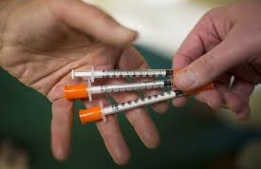
Impacts on Stigmatized Populations …
Increase adverse outcomes
Diminish self-esteem
Affect personal relationships at a time they are needed most
Increase involvement in risky behavior
Notes:
In addition to impacts on recovery
Research indicates that stigma contributes to a host of adverse outcomes for stigmatized populations including people with mental health substance use disorders, The impact of stigma both disadvantages the stigmatized individuals and is a major source of stress in their lives.
In face many argue that stigma is in fact a central driver of morbidity and mortality at a population level.
And Emerging evidence indicates that stigma can be discussed as a fundamental cause of health inequalities.
So here’s how to talk about that
Let people know that because Stigma does this through a few mechanisms …
Stigma influences several physical and mental health outcomes that affect millions of people in the United States
Further It disrupts or inhibits access to multiple resources—structural, interpersonal, and psychological—that could otherwise be used to avoid or minimize poor health
Including:
Diminished self-esteem
Can affect personal relationships at a time they are needed most
Increase involvement in risky behavior
Inequalities between stigmatized and non- stigmatized groups are by no means inevitable, We will talk later in this recording about what can all do about
Stigma as a Fundamental Cause of Population Health Inequalities
https://www.ncbi.nlm.nih.gov/pmc/articles/PMC3682466/

Slide 11



A Statement on Language
How we refer to individuals with substance-related conditions and that use of, and exposure to, the “abuser” label may inadvertently elicit and perpetuate stigmatizing attitudes.
(Substance Abuse and Mental Health Services Administration, 2008)
Notes:
Now lets clarify what we mean by person first language
The language we use to discuss mental health and substance use disorders (SUDs) either formally, as part of our organization or professions messaging, or informally, in conversations with colleagues and stakeholders, can either increase or decrease stigma.
In the context of the growing opioid crisis, the language we use becomes particularly important as many of us now find ourselves working in partnership with people who actively misuse substances.
Remembering that Public stigma is driven by stereotypes about people, in this case with opioid use disorders, such as their perceived dangerousness or perceived moral failings, which translate into negative attitudes toward people with opioid use disorders. Unchecked these stereotypes can become encoded in cultural norms, laws, and lead to discriminatory policies.
Here’s how this can happen
One community I have worked with recently provides an example
In this small town local leaders came up with what I think is a discriminatory policy solution in response to both compassion and real resource fatigue
After years of dedicating resources through first responders administering naloxone as large part of their day realized they were doing overdose reversals with some of the same individuals again and again.
The solution was to set a limit on how many times and under what conditions local first responders would administer naloxone. One aspect of this proposed policy was to require individuals to give back and perform community service if they had a second or third overdose reversal. I don’t think we would treat others this way. This policy seemed grounded in a negative inaccurate belief or stereotype about individuals with OUD. Implies that they have control and that’s its somehow their fault. Two of the most pervasive conditions that we must work against in the perpetuation of stigma.
Before we leave this conversation Now take a moment to consider the significant challenges in rural America in relation to the opioid crisis. Limited resource, access to opioid specific treatment, and the geography the distance people are from one another. Are there other solutions we could offer these local leaders. We will talk about how address public stigma later in this recording.

Slide 12
Affirming Language
Adopted by the ASAM Board of Directors September 15, 2019
Notes:
Back up is that position statement we talked about at the beginning.
This serves as a great example of some simple steps you can take. Consider developing a position of your coalition, your agency, your organization and then disseminate that message through all the channels already in place. That can include your agency brochures and all your training materials.

Slide 13

Commonly Studied Dimensions of Stigma
Blame - individuals are to blame (control and fault).
Social Distance - would I have them marry into my family.
Dangerousness - are they unexpectedly volatile, a threat to my safety.
Notes:
Blame – are they responsible for causing their problem/disorder
Prognostic pessimism/optimism – will they even recover “be normal”, “trustworthy”
Social Distance – would I have them marry into my family, share an apartment with them, have them as a babysitter?
Dangerousness – are they unpredictably volatile, a threat to my/other safety?

Slide 14

What We Are Learning
SUD are more stigmatized
People with SUD are perceived as more to blame for their disorder
Patients themselves who hold more stigmatizing beliefs about SUD are less likely to seek treatment
Describing SUD as treatable helps
Notes:
Compared to other psychiatric disorders, SUD is more stigmatized
Compared to other psychiatric disorders, people with SUD are perceived as more to blame for their disorder
Patients themselves who hold more stigmatizing beliefs about SUD are less likely to seek treatment
Describing SUD as treatable helps
A large body of research indicates that this stigma is persistent, pervasive, and rooted in the belief that addiction is a personal choice reflecting a lack of willpower and a moral failing. Though the severity of the stigma varies with the particular drug being used, evidence shows that stigmatizing beliefs underlie views about addiction in general.

Slide 15


Language Matters
The word ‘abuser' implies volitional acts of willful misconduct, and is associated with things like child abuse,"
‘substance use disorder' conveys something very different — a medical disorder. Substance use is the only thing we talk about this way.
Notes:
JOHN F. KELLY, PH.D., ABPP
Founder and Director of the Recovery Research Institute (RRI) at Massachusetts General Hospital
Kelly has helped us to understand the impact of the word abuse and in particular how it leads the use of term abuser
The word ‘abuser' implies volitional acts of willful misconduct, and is associated with things like child abuse,"
‘substance use disorder' conveys something very different — a medical disorder.
Substance use is the only thing we talk about this way.
He often cites the example that People with eating-related conditions are always referred to as “having an eating disorder”, never as “food abusers”.

Slide 16
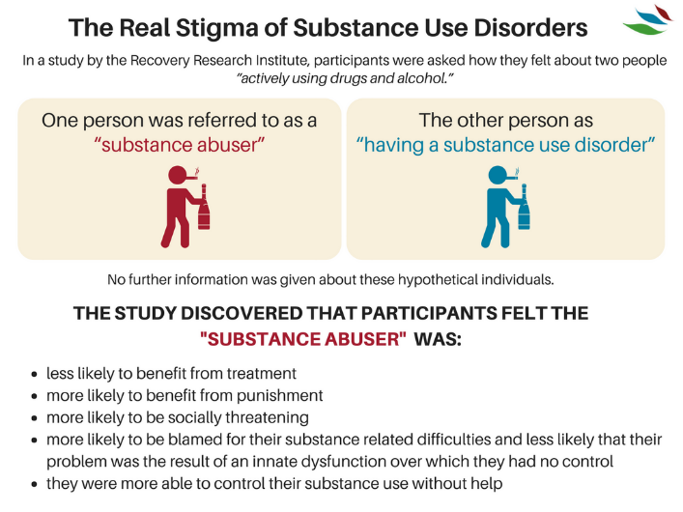

Findings
The use of "substance abuser" increased participants’ believing that the character was personally responsible for his actions and should even be punished for them.
Additional Beliefs about “Substance Abusers”
Notes:
Now lets take a look at what Kelly Found:
In the study, he surveyed more than 500 mental health care providers. Each clinician read one of two vignettes about a character with a substance use problem who was in a court-mandated treatment program but had relapsed and had positive urine tests. The vignettes were identical except that in one, the character was described as a "substance abuser" and in the other as someone with a "substance use disorder." He found that the clinicians who read the vignette about the "substance abuser" were significantly more likely to say that the character was personally responsible for his actions and should be punished for them (International Journal of Drug Policy, 2010).
Participants in the study also felt that substance abuser as compared to the individual with a substance use disorder was
Less likely to benefit from treatment, more likely to benefit from punishment, be socially threatening , and more likely to be blamed and more able to control their use without help. Take a moment and think about all the implications of those beliefs and how they could contribute to all three levels of stigma we talked about earlier
Kelly suggests, in addition to "substance use disorder," using such non-stigmatizing words as "misuse," "hazardous use," "harmful use" and "unhealthy use."
https://www.recoveryanswers.org/research-post/the-real-stigma-of-substance-use-disorders/

Slide 17
Significance of Descriptive Labels
Subscales Comparing the “Substance Abuser” and “Substance Use Disorder” Labels
.90
.80
.70
.60
.50
.40
.30
.20
.10
.00
Substance Abuser
Substance Use Disorder
0.76
0.79
0.69
0.67
0.67
Mean of Subscale Score
0.58
0.41
0.42
0.33
0.23
0.24
0.21
Treatment Punishment Social Threat Blame Exoneration Self-regulation
Source: Kelly, J. F., Dow, S. J., & Westerhoff, C. (2010) Does Our Choice of Substance-Related Terms Influence Perceptions of Treatment Need? An Empirical Investigation with Two Commonly Used Terms. Journal of Drug issues, 40(4), 805-818
Notes:
Here’s a graph showing what we just talked about comparing the use of labels.
Look that significant differences where participants landed on punishment and exoneration.
And self regulation, almost twice as likely to believe that abuser could self regulate as opposed to an individual with a disorder

Slide 18
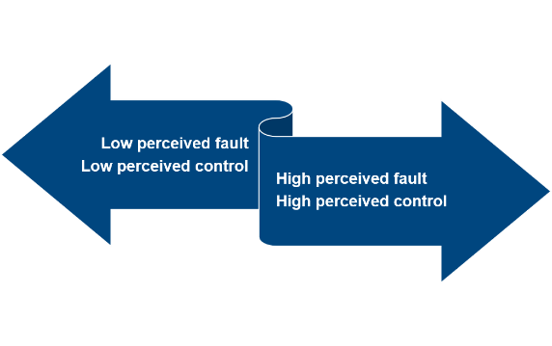
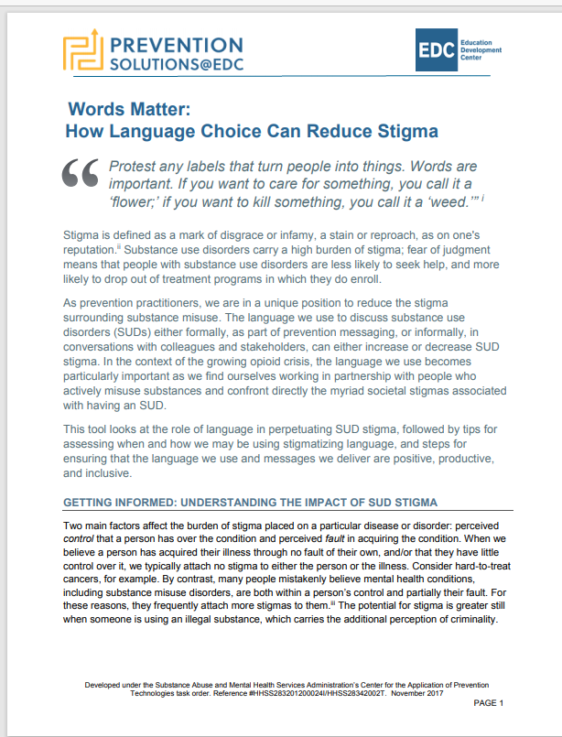
Language and Stigmatized Conditions
Non-Stigmatizing Conditions
Stigmatizing Conditions
Person first language (for example, reference to “a person with substance use disorder”) suggests that the person has a problem that can be addressed. By contrast, calling someone a “drug abuser” implies that the person is the problem.
Words Matter: How Language Choice Can Reduce Stigma PreventionSolutions@EDC
Notes:
This image presents us with a way of thinking about conditions in our community
Starting on the right If people in our community believe that individuals with substance use disorders are at fault and could stop if they wanted to – we are likely to see lots of public stigma, prejudice and discrimination.
If we can increase community members understanding of addiction thereby reducing perceived fault and control, we can expect to see less public stigma and sdiscrimination
Clearly increasing the use of person first language can play a significant role in shifting community conditions in the right direction

Slide 19
Language Matters
Substance Use Disorder
Person with a substance use disorder
Positive drug screen
Recurrence of use
In recovery, abstinent or in remission
Substance Abuse
Addict
Substance abuser Junkie
Dirty drug test
Relapse
Off the wagon
Clean
Ex-addict
Notes:
Present your colleagues with information about language and offer alternatives for non stigmatizing language
Which of the stigmatizing words have you heard used where you live or work.
Remember we talked about earlier that often the use of stigmatizing language is not intentional
IT bears repeating that we don’t want to put ourselves in the position of enforcers of political correctness.
At the same time we all need to take a role in reframing the conversations and language that perpetuates stigma.
As we talked about, pulling someone aside discreetly, privately to remind them about the importance of language is often more productive that embarrassing someone. .

Slide 20
‘ADDICION-ARY’ ADVICE
ABUSER, ADDICT
Use “person first” language: Rather than call someone as addict, say he or she suffers from addiction or a substance use disorder.
DRUG
Use specific terms such as “medication” or a non-medically used psychoactive substance” to avoid ambiguity.
CLEAN, DIRTY
Use proper medical terms for positive or negative test results for substance use.
LAPSE, RELAPSE, SLIP
Use morally neutral terms like “resumed” or experienced a “recurrence” of symptoms.
HMS Professor John Kelly helped to create the Addiction-ary, a glossary of addiction-related terms to help medical professionals and the general public modify their language about addiction. Graphic by Rebecca Coleman/Harvard Staff
Notes:
The Recovery Research Institute's glossary of addiction-related term flags several entries with a “stigma alert” based on research that suggests they induce bias. A sampling:
John Kelly helped to create the Addiction-ary, a glossary of addiction-related terms to help medical professionals and the general public modify their language about addiction. Graphic by Rebecca Coleman/Harvard Staff

Slide 21
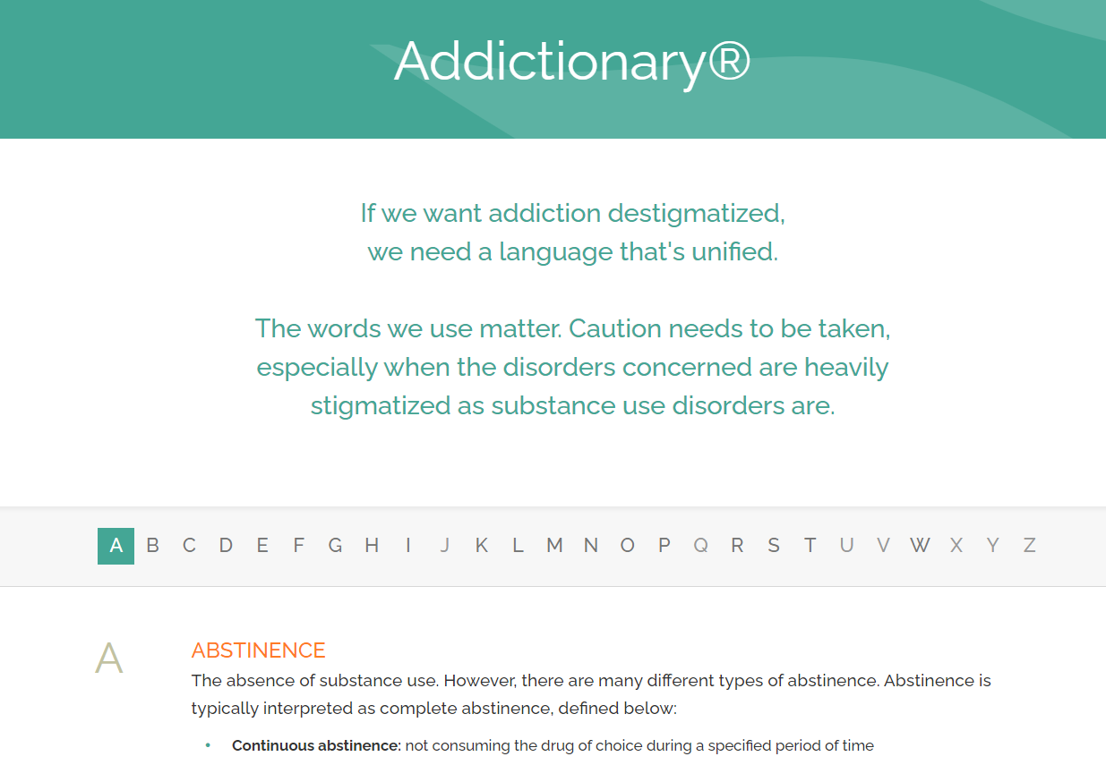
Addictionary - Glossary of Substance Use Disorder Terminology (recoveryanswers.org)
https://www.recoveryanswers.org/addiction-ary/

Slide 22

Poll
My current work on the prevention and reduction of stigma.
Check all that apply
I regularly use person first language
My organization has a position on stigma that I promote
I have reminded others to use person first language
Other (type in the chat)

Slide 23
Cross-cutting Practices

Slide 24




Cross-Cutting Practices to Address Stigma
Increase awareness and knowledge about mental and substance use disorders.
Educate about stigmatizing language and its impact on population health.
Notes:
Now we are in the home stretch.
Before we talk about evidence based strategies, we think its important to identify what we call cross cutting practices.
These are based on principles that drive our work on stigma prevention
Things we can all do regardless of what we do where we work include the following
Increase awareness and knowledge about SUD and mental health
Educate about stigmatizing language and its impact on population health

Slide 25


Cross-cutting Practices
Enhance support and resources to entities who are working with SUD and mental health populations
Engage various community partners and stakeholders in conversations about SUD and mental health
Notes:
Further we can
Enhance support and resources to entities who are working with SUD and mental health populations
Engage various community partners and stakeholders in conversations about SUD and mental health

Slide 26

More Cross-Cutting Practices
Provide opportunities for interaction with individuals with substance use or mental health disorders
Promote peer programs in which people who have disclosed their conditions offer their experience and expertise.
Notes:
Finally, we can all work to
Provide opportunities to interact with people with substance use or mental health disorders
Contact-based education uses social contact as a way to improve relations, and dispel stereotypes, among groups that are experiencing stigma and discrimination
Stigma is reduced by providing an opportunity for interpersonal contact between people who have a mental or substance use disorder and audiences who may be stigmatizing towards them or simply who need to work with them in culturally relevant and non stigmatizing ways
Promote peer programs in which people who have disclosed their conditions offer their experience and expertise.
Quick but important caveat. Involvement of those individuals needs to be preceded by opportunities to guide participants who are considering disclosure to make informed decisions considering the risks and benefits of disclosure.

Slide 27



What Works
Structural Stigma
Professional Education
Advocacy
Legal
Policy
National Academies of Sciences, Engineering, and Medicine. (2016). Ending Discrimination Against People With Mental and Substance Use Disorders: The Evidence for Stigma Change.
Notes:
We will take a look at strategies at three levels Structural, Public, and Self Stigma
You recall that talked earlier about structural stigma as Prejudice and discrimination by policies, laws, and constitutional practice; also called institutionalized stigma at the societal level or community level
Targets of structural stigma would include legislators, institutions, and policy makers of systems and organizations that fund and regulate the places and situations where discrimination
The interventions that would be appropriate for this level are legal, policy, advocacy, and professional education strategies.
Strategies would be aimed at changing decision-making processes, policies, and regulations that support discrimination against people with mental and substance use disorders.

Slide 28

What Works
Public Stigma
Mass Media Messaging
Education
Community Programming
Contact Strategies
National Academies of Sciences, Engineering, and Medicine. (2016). Ending Discrimination Against People With Mental and Substance Use Disorders: The Evidence for Stigma Change.
Notes:
Now we will turn to Public stigma
We talked about this as Stereotypes, prejudice, and discrimination endorsed by the general population a set of negative attitudes and beliefs that motivate individuals to fear, reject, avoid, and discriminate against people with mental illness.
Targets for interventions to reduce public stigma include the general public and landlords, employers, health care providers, and groups within the criminal justice system.
The corresponding interventions would be aimed at changing behaviors and interactions from discrimination, fear, neglect, and sometimes abuse to extending support, high-quality treatment, and equal opportunities for housing, employment, and personal success.
Examples of such interventions include use of media for mass messaging to dispel myths regarding behavioral health disorders and treatment, education to counter the lack of knowledge about disorders and treatment, contact with people with behavioral disorders, and protest strategies against discrimination.

Slide 29

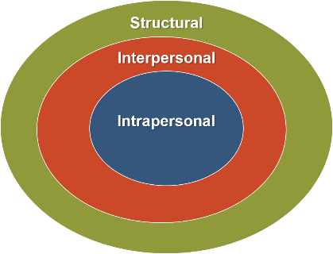

What Works
Self-Stigma
Education
Empowerment
Peer Support
National Academies of Sciences, Engineering, and Medicine. (2016). Ending Discrimination Against People With Mental and Substance Use Disorders: The Evidence for Stigma Change.
Notes:
Finally let’s dive into self stigma
Personal or Self stigma Internalization of public stigma can lead to Shame/guilt and Lowered self-esteem .
For some self stigma can lead to a lack of problem acknowledgment (I am a bad person rather than an individual with a disorder that needs treatment) This can result in Delays in help-seeking, Less treatment engagement, and the creation barriers for recovery
The general effects of self-stigma and the “why try” effect may be diminished by interventions that target individuals with behavioral disorders.
Interventions would focus on promoting self-esteem and self-efficacy; empowerment through peer support, mentoring, and education to dispel myths and increase social and coping skills; and education to encourage treatment engagement
For many individuals, disclosure may be an initial step in the process of reducing self-stigma when it can be done in a safe and strategic manner

Slide 30


Breakout Session 1
Instructions
Elect a Facilitator/ Reporter
Answer the Following Questions
What connects with me from the presentation so far?
What are examples of stigma and / or the impact of it have I seen in my community?
What are some things I would like to do to address stigma where I work or live?

Slide 31

Breakout Session 1
Reporting Out
How was the Conversation ?
People connected to what about stigma…
Examples of Stigma in Indiana communities …
Goals or actions people want to take…

Slide 32

A Role for Everyone
Stigma disproportionately influences health outcomes and mental well-being for individuals with mental health or substance use disorder.
Stigma is not limited to one setting or condition; it cuts across all communities and populations.
Notes:
Present the importance of cross cutting principles as we approach this work and the potential specifically for Prevention
Stigma disproportionately influences health outcomes and mental well-being for individuals with mental health or substance use disorder (SUD). Fear of being judged and/or discriminated against can prevent people from getting the help they need. Stigma is complex due to various societal and research definitions, including it comes in many different forms.
2. Stigma is not limited to one setting or condition, rather it is cross-cutting in all communities and populations.
3. The best approach to stop or prevent stigma is through cross-cutting practices such as:
Increase awareness and knowledge about SUD and mental health
Educate about stigmatizing language and its impact on population health
Enhance support and resources to entities who are working with SUD and mental health populations
Engage various community partners and stakeholders in conversations about SUD and mental health
Provide opportunities to interact with people with substance use or mental health disorders (contact-based education programs)
Promote peer programs in which people who have disclosed their conditions offer their experience and expertise to individuals and families, programs that range from informal peer-led programs to peer specialized services in health services systems." (National Academies Press, 2016)

Slide 33
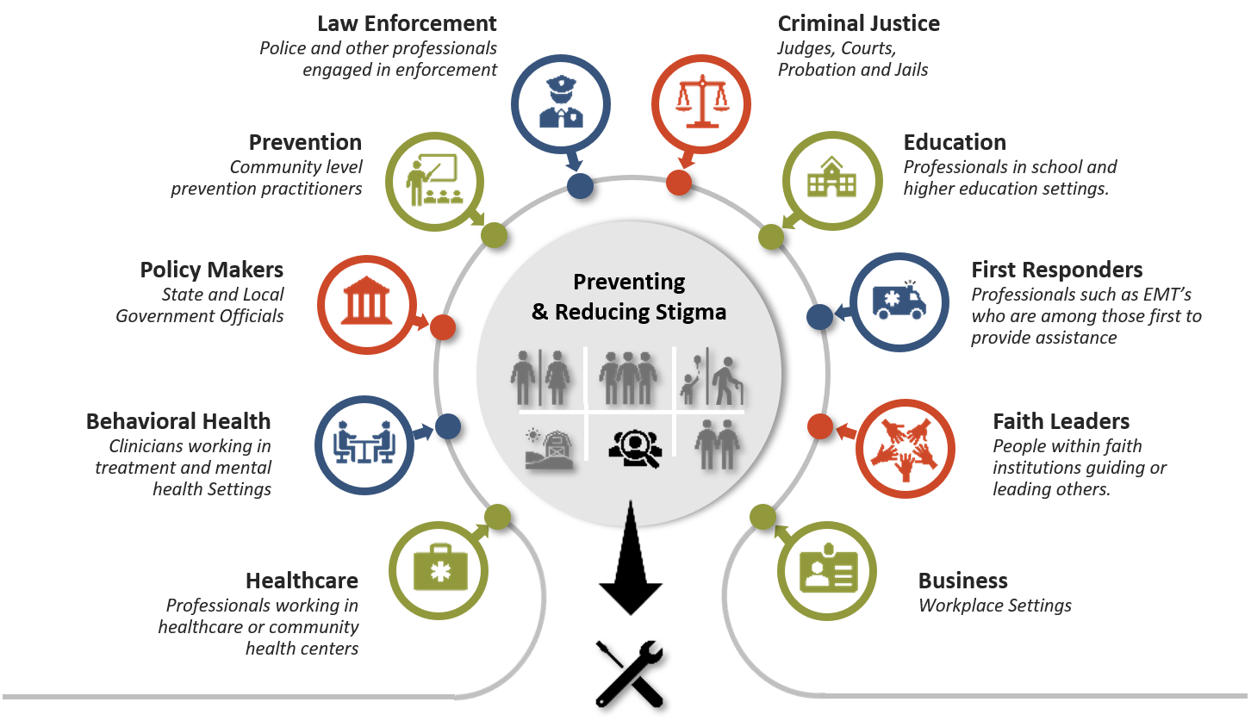
ACTIVITY: Identify Community Sectors
Use “annotate” to place a checkmark next to key sectors you want top engage.
Notes:
Discuss those that are selected and bring out the rationale for each.
Discuss potential partners and collaborations

Slide 34
Poll
The Segment of the Community I want to begin working with the most is:
Select Only One
Healthcare
Behavioral Health
Prevention
Law Enforcement
Criminal Justice
First Responders
Education
Faith Leaders
Business
Policy Makers

Slide 35
The Role for Prevention

Slide 36



Prevention
Why it Matters
Prevention practitioners are in a unique position to reduce the stigma surrounding substance misuse and mental illness:
Formally through messaging
Informally in conversations with colleagues and stakeholders
Notes:
According to the 2017 National Survey on Drug Use and Health, about 8 out of 10 people with a mental health condition reported experiencing shame and stigma that prevented them from seeking treatment.
Stigma can be defined as an attribute, behavior, or condition that socially discredits an individual or populations in various capacities. Stigma disproportionately influences health outcomes and psychological well-being of individuals with mental health and SUD.
Prevention practitioners are in a unique position to reduce the stigma surrounding substance misuse.
The language used to discuss substance use disorders (SUDs) either formally, as part of prevention messaging, or informally, in conversations with colleagues and stakeholders, can either increase or decrease SUD stigma.

Slide 37
Poll
When developing prevention messaging, I typically ask myself
Check all that apply
Who is my intended audience, and how can I use language when communicating with this group
Am I correcting negative attitudes held by colleagues, coworkers, and potential allies.
Am I leveraging all the potential opportunities I have in my prevention role to dispel myths about addiction
Am I maximizing connection, worth, inclusion and community membership
Notes:
Every time you develop a prevention message, consider it as an opportunity to dispel myths and convey respect. Ask yourself: ▪ Who is my intended audience, and how can I use language to reduce stigma when communicating with this group? For example, when developing a message to encourage people with opioid use disorders to carry and use naloxone, include language that fosters self-worth and encourages self-efficacy. ▪ Am I correcting negative attitudes held by potential allies? For example, in some communities, first responders may be reluctant to carry naloxone because they characterize people who misuse opioids as criminals who should be punished for breaking the law. You can help to change this perspective by using language that acknowledges the presence of these stereotypes while educating about the nature of addiction and affirming the shared priority of saving lives.
Am I maximizing connection, worth, and community membership? If not, might shame, isolation, or “othering” be implied by the language used?

Slide 38


Why It Matters
Prevention practitioners often work across the continuum of care.
They have opportunities to influence professionals in various types of settings including mental health, human services, and public health.
Notes:
Prevention practitioners often work across the continuum of care and have opportunities to influence and train professionals who work in various types of settings including mental health, human services, and public health.

Slide 39



Prevention
What’s the Impact
Stigma can affect the disclosure of traumatic experiences.
Fear of stigma may cause a person to suppress thoughts and feelings about trauma, leading to an increase in unhealthy coping skills.
Notes:
Stigma can affect the disclosure of traumatic experiences or suicidality. Fear of stigma may cause a person to suppress thoughts and feelings about trauma, leading to an increase in unhealthy coping skills.
When stigma is internalized, problems associated with depression, self-esteem and stress are elevated, leading to increased risk for substance use and substance use disorders.
Stigma affects a person’s sense of belonging to a community or group, which may increase risk of comorbidities and mortality for people with substance use and mental health disorders.
Stigma also has a negative impact on access to care, especially for underserved populations seeking culturally and linguistically appropriate services.

Slide 40


What’s the Impact
Stigma affects a person’s sense of belonging to a community or group
Stigma also has a negative impact on access to care, especially for underserved populations
Notes:
Stigma affects a person’s sense of belonging to a community or group, which may increase risk of comorbidities and mortality for people with substance use and mental health disorders.
Stigma also has a negative impact on access to care, especially for underserved populations seeking culturally and linguistically appropriate services.

Slide 41

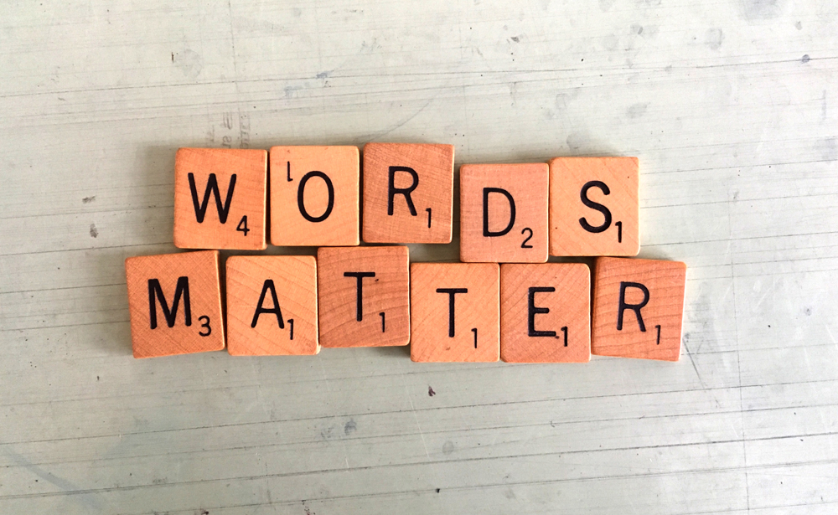
Prevention
What Can Be Done
Employ pro-health messaging and use person-first language
Conduct a language audit of prevention training materials to remove stigmatizing language
Notes:
Pro- health messaging
Person first language - People-first language (PFL), also called person-first language (PFL), is a type of linguistic prescription which puts a person before a diagnosis, describing what a person "has" rather than asserting what a person "is".
Perform a “language audit” of existing materials for language that may be stigmatizing, then replace with more inclusive language. For example, using the search and replace function for electronic documents: search for “addict” and replace with “person with a substance use disorder,” or search for “abuse” and replace with “use” or “misuse.” Make sure to review both internal documents (mission statements, policies) as well as external ones (brochures, patient forms).

Slide 42



What Can Be Done
Support and enhance individual coping strategies for people in stigmatized groups
Provide information and support to stigmatized groups
Notes:
Support and enhance individual coping strategies for people in stigmatized groups.
Support prevention educational strategies that provide information and support to stigmatized groups on making healthier decisions.
language that supports pro-health activities, even if a person is actively using substances, can help decrease stigmas. For example, prevention messages that highlight the self-efficacy of people with SUDs to use naloxone to reverse opioid overdose frames them as capable and important community members, and directly tackles existing stigmas of people with SUDs as selfish and lazy.

Slide 43



Prevention Can…
Shape public views on substance use disorders and mental illness
Engage community stakeholders in discussions
Change laws and policies that contribute to stigma
Notes:
The language practitioners use to talk about substance misuse shapes how the public views substance use disorders. Unintentionally stigmatizing language can perpetuate negative stereotypes about the types of people who are affected by substance misuse and can decrease public support for prevention and treatment programs.
Engage community stakeholders in discussion on how stigma affects mental health and SUD.
Implement interventions that change laws and policies that enhance stigma around mental illness and SUD.

Slide 44
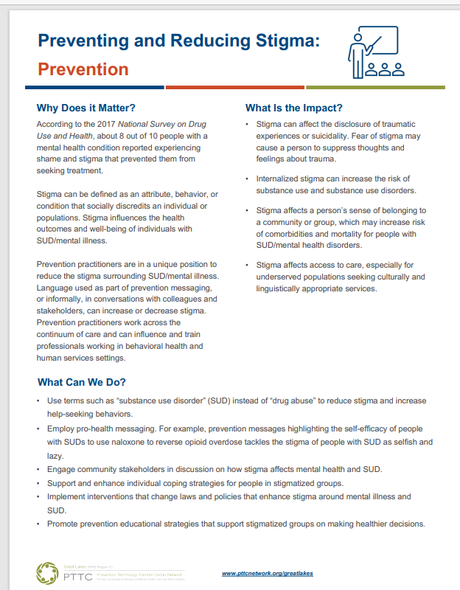
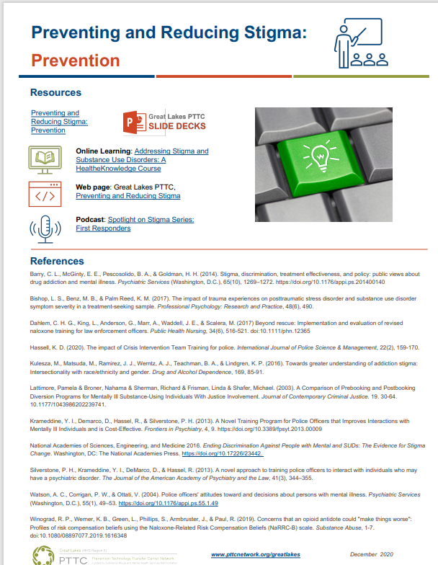
Resources on the PTTC Site

Slide 45
Poll
I would feel comfortable doing this in my role as preventionists.
Check all that apply
Employ person first language, formally and informally
Conduct a language audit of prevention training materials
Provide information and support for stigmatized populations
Engage community stakeholders in discussions about stigma
Advocate for anti discrimination policy

Slide 46

Breakout Session 2
Instructions
Elect a Facilitator/ Reporter
Answer the Following Questions
Why did I select this community segment to begin addressing stigma?
What are some of the ways I can begin engaging professionals who work in this segment?
What do I anticipate as barriers I may encounter in working with them?

Slide 47
Breakout Session 2
Reporting Out
What segment did you talk about ?
How was the conversation ?
What do people want to do?
Anticipated barriers to getting started?

Slide 48
Creating a Local Plan for Preventing and Reducing Stigma

Slide 49

Plan Your Stigma Prevention Journey
Assess the Landscape

Slide 50
Assessing the Landscape
What evidence do you Have that stigma is an issue?
  Data – quantitative and qualitative
What campaigns—state or local—are already being implemented?
  Know
What relationships do we already have at the community level?
  What’s our capacity and reach?

Slide 51
Poll
I have aware of or already support the following National or IN initiatives
Check all that apply
Faces and Voices of Recovery
Shatterproof – Ending Addiction Stigma
Stop the Stigma: Tackling the Stigma of Addiction through Education – Alcohol Policy Forum
NextLevel Recovery – Indiana
Other local anti-stigma campaign (type in the chat)
Notes:
Faces and Voices
https://facesandvoicesofrecovery.org/
We provide the addiction treatment and recovering community with practical information and tools to enhance their capacity to engage in effective stigma reduction efforts. We facilitate a national conversation for Americans in recovery, their friends, families and allies as well as those still suffering. We are committed to eliminating stigma, shaping public policy and educating people by bringing recovery into the consciousness of Americans. We accomplish this through the promotion and celebration of recovery, by demonstrating recovery as a positive healing force, and by being the voice for those who have not yet found theirs. We support all pathways to recovery and we support initiatives such as Recovery Day, Rally for Recovery and Recovery Month.
We encourage those in recovery from addiction, and their friends, family members and allies to build awareness, challenge societal stigma
Shatterproof
https://www.shatterproof.org/our-work/ending-addiction-stigma
Includes stigma against medications for use with opioid use disorders
https://www.shatterproof.org/sites/default/files/2020-07/A-Movement-to-End-Addiction-Stigma.pdf
Stop thee Stigma: Tackling the Stigma of Addiction Through Education The Addiction Policy Forum together with Toni and Christopher Cornell have launched a nationwide campaign entitled “Stop the Stigma: Tackling the Stigma of Addiction through Education.” With support from the Chris and Vicky Cornell Foundation, the national campaign will address the stigma and discrimination that people with a substance use disorder face through an awareness campaign, a podcast, and workshops and trainings for key stakeholders and the public. The campaign will also focus on data collection to measure the incidence and prevalence of stigma, as well as the effectiveness of interventions and resources.
https://recoveryreinvented.com/about/
https://recoveryreinvented.com/wp-content/uploads/2019/11/Language-of-Recovery-terminology.pdf

Slide 52
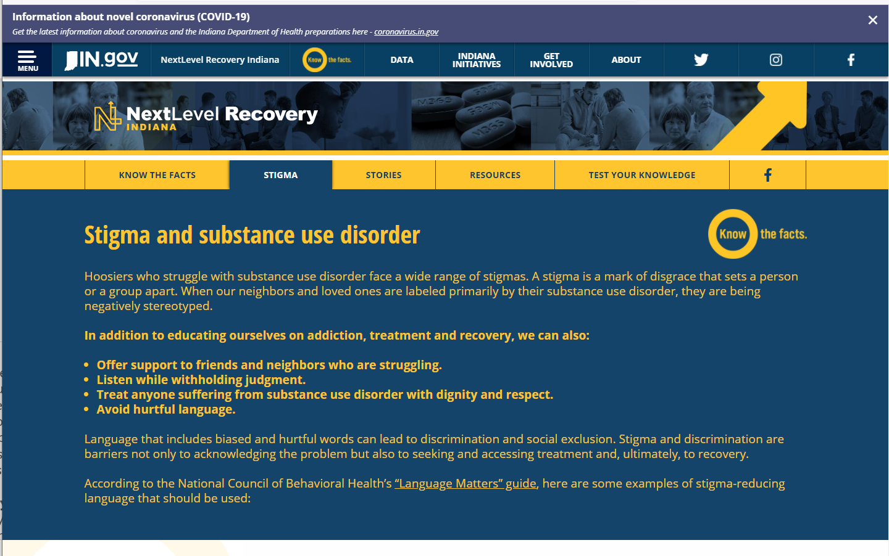

Indiana Campaign
Notes:
Fill with Care
Using prescriptions and Preventing OD https://www.behavioralhealth.nd.gov/opioids/addiction
Also incudes information on Understanding Addiction: The good news is, addiction to opioids - or Opioid Use Disorder - is a treatable chronic disease. The best treatment for Opioid Use Disorder is FDA-approved medication (such as buprenorphine or methadone) in combination with behavioral therapy. Learn more about the impact of opioids and request a free Narcan kit. Every aspect of the opioid crisis requires great care. From understanding the risks and benefits of pain medications to knowing the signs of addiction, to recognizing an overdose and knowing how to help - there are ways all of us can care for each other and ourselves. Fill your understanding of opioids with care, and together we'll protect North Dakota.
Recovery Reinvented https://recoveryreinvented.com/about/
Recovery Reinvented is an ongoing series of innovative practices and initiatives to eliminate the shame and stigma of addiction in North Dakota. We are uniting to find solutions to help people in our state affected by the disease of addiction with proven prevention, treatment and recovery approaches.
Stop Overdose https://prevention.nd.gov/
Developed as a resource for law enforcement, pharmacists, and emergency medical service professionals, these materials provide a brief overview of the signs of an opioid overdose, steps for responding to overdose, and how to become approved to carry naloxone.
Jamestown ride to silence stigma https://www.newsdakota.com/2020/07/06/7th-annual-ride-to-silence-the-stigma/

Slide 53
Plan Your Stigma Prevention Journey
Assess Your Impact
Begin Implementation
Build Support for the Plan
Create a Cross-Sector Prevention Plan
Create or Strengthen Collaborations
Identify and Select Evidence-Based Strategies
Identify Community Sectors to Engage
Clarify Stigma Prevention Goal
Assess the Landscape

Slide 54
Elements of your Plan
Organization’s Mission
  Alignment with Stigma
Goal for Reducing Stigma
  Rationale for the Goal
Sectors Involved in the Plan
  Roles for Each Key Sector
Implementation Plan
  Actions and Timeframes
Impact
  How We Measure Success

Slide 55

A Virtual Tour
Great Lakes PTTC | Prevention Technology Transfer Center (PTTC) Network (pttcnetwork.org)
https://pttcnetwork.org/centers/great-lakes-pttc/home

Slide 56
Questions?

Slide 57
Contact:
Chuck Klevgaard, Prevention Manager
Great lakes PTTC
Cklevgaard@edc.org

Slide 58
References
Intervening within and across levels: A multilevel approach to stigma and public health. Cook, J. E., Purdie-Vaughns, V., Meyer, I. H., & Busch, J. T. (2014) Social Science & Medicine, 103, 101-109.
The Public Stigma of Mental Illness and Drug Addiction: Findings from a Stratified Random Sample. Corrigan, P.W., Kuwabara, SA., O’Shaughnessy, J. (2009). Journal of Social Work. (9)(2): 139-147
Does our choice of substance-related terms influence perceptions of treatment need? An empirical investigation with two commonly used terms. Kelly, J. F., Dow, S. J., & Westerhoff, C. (2010). Journal of Drug Issues, 40(4), 805-818
Does it matter how we refer to individuals with substance-related conditions? A randomized study of two commonly used terms. Kelly, J. F., & Westerhoff, C. M. (2010). International Journal of Drug Policy, 21(3), 202-207
Stop Talking "Dirty": Clinicians, Language, and Quality of Care for the Leading Cause of Preventable Death in the United States. Kelly, J. F., Wakeman, S. E., & Saitz, R. (2015). The American journal of medicine, 128(1), 8-9.
The effectiveness of interventions for reducing stigma related to substance use disorders: a systematic review. Livingston, J. D., Milne, T., Fang, M. L., & Amari, E. (2012). Addiction, 107(1), 39-50.VAddiction, 107(1), 39-50
Ending Discrimination Against People with Mental and Substance Use Disorders: The Evidence for Stigma Change. Washington, DC: The National Academies Press.

Slide 59






















A Role for Every Sector
Law Enforcement
Police and other professionals engaged in enforcement
Criminal Justice
Judges, Courts, Probation and Jails
Prevention
Community level prevention practitioners
Education
Professionals in school and higher education settings.
Preventing
& Reducing Stigma
Policy Makers
State and Local Government Officials
First Responders
Professionals such as EMT’s who are among those first to provide assistance
Behavioral Health
Clinicians working in treatment and mental health Settings
Faith Leaders
People within faith institutions guiding or leading others.
Healthcare
Professionals working in healthcare or community health centers
Business
Workplace Settings
EMPOWERMENT and RESILIENCE
Notes:
One Final Reminder
Stigma is not limited to one setting or condition; rather, it is cross-cutting in all communities and populations.
Consider working in partnership with existing groups, task forces, or coalitions, and strive to include as many community segments as you can.
The PTTC website has slide decks on 10 community segments, each emphasizing the importance for that segment, the impact on stigmatized populations, and programs practices or policies shown to be effective at preventing or reducing stigma within that segment.

Slide 60

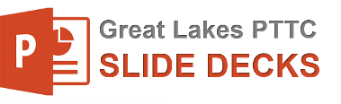
Preventing and Reducing Stigma: Evidence-based Practices
My Town, USA
Presenter
Organization
Date
Notes:
Welcome to this recorded webinar on Preventing and Reducing Stigma
You may be listening today simply to increase your understanding of stigma and how to reduce it, others of you may be listening as trainers or community mobilizers to prepare yourselves to take action that include making presentations of your own
For those of you who are trainers, keep know that the slides you are about to see can be downloaded and customized for your own use.
As you can see on this title, you can add your local organization or town, and who is presenting
In addition, you will find slide sets focused on individual community sectors or types of professionals such as criminal justice or prevention specialists
We are so glad you joined us to learn about this important topic.
This slide serves as a placeholder for you to insert basic information on stigma form the “Stigma basics slide deck”

