Slide 1


Preventing and Reducing Stigma: Evidence-based Practices Across Community Sectors Series
Presenter
Organization
Date

Slide 2


Brought To You By:
The Great Lakes ATTC, MHTTC, and PTTC are funded by the Substance Abuse and Mental Health Services Administration (SAMHSA under the following cooperative agreements:
  Great Lakes ATTC: 1H79TI080207-03
  Great Lakes MHTTC: IH79SM-081733-01
  Great Lakes PTTC: 1H79SP081002-01

Slide 3
Disclaimer
This presentation was prepared for the Great Lakes PTTC under a cooperative agreement from the Substance Abuse and Mental Health Services Administration (SAMHSA). All material appearing in this presentation, except that taken directly from copyrighted sources, is in the public domain and may be reproduced or copied without permission from SAMHSA or the authors. Citation of the source is appreciated. Do not reproduce or distribute this presentation for a fee without specific, written authorization from the Great Lakes PTTC.
At the time of this presentation, Elinore F. McCance-Katz, served as SAMHSA Assistant Secretary. The opinions expressed herein are the views of the speakers and do not reflect the official position of the Department of Health and Human Services (DHHS), SAMHSA. No official support or endorsement of DHHS, SAMHSA, for the opinions described in this document is intended or should be inferred.
November 2020
Notes:
This presentation was prepared for the Great Lakes PTTC under a cooperative agreement from the Substance Abuse and Mental Health Services Administration (SAMHSA).
The opinions expressed in this webinar are the views of the speakers and do not reflect the official position of the Department of Health and Human Services (DHHS), SAMHSA.

Slide 4

Adopted by the ASAM Board of Directors September 15, 2019
Notes:
Read the slide text and ask participants to reflect on and apply this to the dialogue.

Slide 5
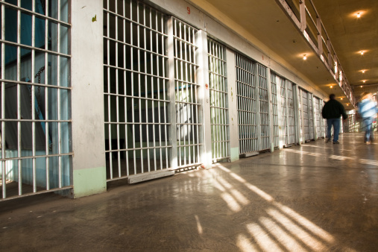
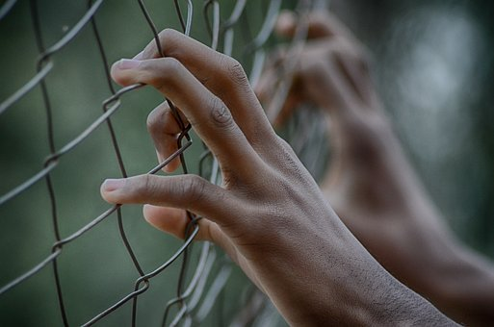


Preventing and Reducing Stigma Cross Sector Slide Deck
Criminal Justice
Impact and Evidence-based Strategies for Preventing and Reducing Stigma
Notes:
Introduce Yourself
Welcome participants to the Webinar, Training, Learning Opportunity
Say something about what addressing stigma means to you or Why you believe its important to have this dialogue

Slide 6
Learning Objectives
Participants will be able to:
Describe why addressing stigma within criminal justice systems is important
List the potential impact of stigma and the role that criminal justice can play
List strategies for engaging criminal justice leaders in the prevention and reduction of stigma
Notes:
Quickly Review the Objectives for Today
Describe why addressing stigma within criminal justice systems is important
List the potential impact of stigma and the role that criminal justice can play
List strategies for engaging criminal justice leaders in the prevention and reduction of stigma

Slide 7





















A Role for Every Sector
Law Enforcement
Police and other professionals engaged in enforcement
Criminal Justice
Judges, Courts, Probation and Jails
Prevention
Community level prevention practitioners
Education
Professionals in school and higher education settings.
Preventing
& Reducing Stigma
Policy Makers
State and Local Government Officials
First Responders
Professionals such as EMT’s who are among those first to provide assistance
Behavioral Health
Clinicians working in treatment and mental health Settings
Faith Leaders
People within faith institutions guiding or leading others.
Healthcare
Professionals working in healthcare or community health centers
Business
Workplace Settings
EMPOWERMENT and RESILIENCE
Notes:
Make the Point that Behavioral Health workers have not been singled out as the cause or the only solution to addressing stigma.
The purpose of todays discussion is to identify opportunities rather than blame.
Encourage the leaders or faith partners to listen and share what they are thinking, learning and doing including
Invite them to share what segments that have seen addressing stigma in a positive way

Slide 8

A Role for Everyone
Stigma disproportionately influences health outcomes and mental well-being for individuals with mental health or substance use disorder.
Stigma is not limited to one setting or condition; it is cross-cutting in all communities and populations.
Notes:
Present the importance of cross cutting principles as we approach this work and the potential specifically for the criminal justice system
Stigma disproportionately influences health outcomes and mental well-being for individuals with mental health or substance use disorder (SUD). Fear of being judged and/or discriminated against can prevent people from getting the help they need. Stigma is complex due to various societal and research definitions, including it comes in many different forms.
2. Stigma is not limited to one setting or condition, rather it is cross-cutting in all communities and populations.
3. The best approach to stop or prevent stigma is through cross-cutting practices such as:
Increase awareness and knowledge about SUD and mental health
Educate about stigmatizing language and its impact on population health
Enhance support and resources to entities who are working with SUD and mental health populations
Engage various community partners and stakeholders in conversations about SUD and mental health
Provide opportunities to interact with people with substance use or mental health disorders (contact-based education programs)
Promote peer programs in which people who have disclosed their conditions offer their experience and expertise to individuals and families, programs that range from informal peer-led programs to peer specialized services in health services systems." (National Academies Press, 2016)

Slide 9




Criminal Justice
Why it Matters
People with mental health and SUDs are overrepresented in the criminal justice system.
More than half of all inmates in the U.S. have a mental illness.
Notes:
Lets get started by looking at why to look at stigma through a criminal justice lens
People with mental health and SUDs are overrepresented in the criminal justice system. More than half of all inmates in the U.S. have a mental illness. Individuals with mental illness are more likely to experience multiple arrests and incarcerations.
In most states, people with mental illness reside in prisons or jails than in state-operated psychiatric facilities.
Up to 70% of youth in state and local juvenile justice systems have a mental illness.

Slide 10
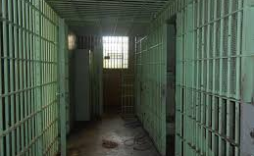
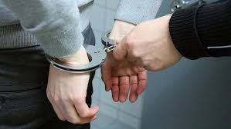
Why it Matters
People with mental illness reside in prisons or jails more often than in state-operated psychiatric facilities.
Individuals with mental illness are more likely to experience multiple arrests and incarcerations.
Notes:
People with mental illness reside in prisons or jails more often than in state-operated psychiatric facilities.
Individuals with mental illness are more likely to experience multiple arrests and incarcerations.

Slide 11

Criminal Justice
What’s the Impact
Societal stereotypes, prejudice, and isolating people to control substance use promotes shame and structural stigmatization due to antidrug and harsh criminal sentences.
Notes:
Lets take a look at the potential impact
Societal stereotypes, prejudice, and isolating people to control substance use promotes shame and structural stigmatization due to antidrug and harsh criminal sentences.
Overrepresentation of people with mental illness and SUD in the criminal justice system is both a source and a consequence of stigma.

Slide 12

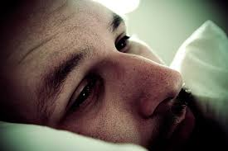
What’s the Impact
Structural stigma plays a role in the disproportional representation.
SUDs are treated as a moral and criminal issue rather than a health condition, which may worsen the effects of incarceration.
Notes:
SUDs are treated as a moral and criminal issue rather than a health condition, which may worsen the effects of incarceration.
Structural stigma plays a role in the disproportionate representation of people with mental illness in the criminal justice system.
Perceived and structural stigma plays a specific role in the criminal justice system. Structural stigma arises when policies reinforce public stigma and restrict the behavior of the stigmatized group. In contrast, perceived stigma refers to perceptions of the public's stigmatizing attitudes and negative stereotypes toward a group. Both types of stigma are thought to affect self-esteem and self-efficacy (the belief that one can make a positive behavioral change), which, in turn, influence expectations about future interactions with society, mental health, behavior, and coping.

Slide 13

Criminal Justice
What Can We Do
Increase trainings about mental health and SUDs for all personnel
Examine data on the arrests of people with mental illness and SUDs.
Notes:
Increase trainings about mental health and SUDs for all personnel and professionals working across the criminal justice system.
Examine the arrests of people with mental illness and SUDs.

Slide 14


What Can We Do
Engage community stakeholders in building mental health and SUD awareness.
Increase awareness of stereotypes within court systems.
Notes:
Establish county-level mental health programs and courts to address stigma, negative attitudes, and prejudice towards people with mental illness and substance use disorder.
Engage community stakeholders in building mental health and SUD awareness, including landlords, employers, healthcare providers, and groups within the criminal justice system.
Increase awareness of stereotypes within court systems, including negative attitudes towards people with mental health illness and SUD and the use of stigmatizing language.

Slide 15
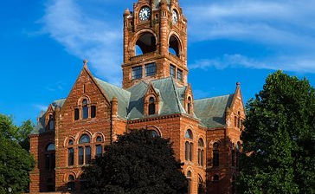

We Can…
Establish county-level mental health programs and courts to address stigma, negative attitudes, and prejudice towards people with mental illness and substance use disorder.
Notes:
Establish county-level mental health programs and courts to address stigma, negative attitudes, and prejudice towards people with mental illness and substance use disorder.

Slide 16

Questions

Slide 17

Follow Us On Social Media!
Facebook and Twitter:
  @GreatLakesATTC
  @GMhttc
  @GLPTTC
Photo: iStock
Notes:
If you would like to know more about what we are doing or information on upcoming events, please see our social media pages

