Slide 1


Preventing and Reducing Stigma: Evidence-based Practices Across Community Sectors Series
Presenter
Organization
Date

Slide 2


Brought To You By:
The Great Lakes ATTC, MHTTC, and PTTC are funded by the Substance Abuse and Mental Health Services Administration (SAMHSA under the following cooperative agreements:
  Great Lakes ATTC: 1H79TI080207-03
  Great Lakes MHTTC: IH79SM-081733-01
  Great Lakes PTTC: 1H79SP081002-01

Slide 3
Disclaimer
This presentation was prepared for the Great Lakes PTTC under a cooperative agreement from the Substance Abuse and Mental Health Services Administration (SAMHSA). All material appearing in this presentation, except that taken directly from copyrighted sources, is in the public domain and may be reproduced or copied without permission from SAMHSA or the authors. Citation of the source is appreciated. Do not reproduce or distribute this presentation for a fee without specific, written authorization from the Great Lakes PTTC.
At the time of this presentation, Elinore F. McCance-Katz, served as SAMHSA Assistant Secretary. The opinions expressed herein are the views of the speakers and do not reflect the official position of the Department of Health and Human Services (DHHS), SAMHSA. No official support or endorsement of DHHS, SAMHSA, for the opinions described in this document is intended or should be inferred.
November 2020
Notes:
This presentation was prepared for the Great Lakes PTTC under a cooperative agreement from the Substance Abuse and Mental Health Services Administration (SAMHSA).
The opinions expressed in this webinar are the views of the speakers and do not reflect the official position of the Department of Health and Human Services (DHHS), SAMHSA.

Slide 4

Adopted by the ASAM Board of Directors September 15, 2019
Notes:
Read the slide text and ask participants to reflect on and apply this to the dialogue.

Slide 5




Preventing and Reducing Stigma Cross Sector Slide Deck
First Responders
Impact and Evidence-based Strategies for Preventing and Reducing Stigma
Notes:
Introduce Yourself
Welcome participants to the Webinar, Training, Learning Opportunity
Say something about what addressing stigma means to you or Why you believe its important to have this dialogue

Slide 6
Learning Objectives
Participants will be able to:
Describe why addressing stigma with first responders is important
List the potential impact of stigma and the role that first responders can play
List strategies for engaging first responders in the prevention and reduction of stigma
Notes:
Quickly Review the Objectives for Today
Describe why addressing stigma within first responders is important
List the potential impact of stigma and the role that first responders can play
List strategies for engaging first responders in the prevention and reduction of stigma

Slide 7





















A Role for Every Sector
Law Enforcement
Police and other professionals engaged in enforcement
Criminal Justice
Judges, Courts, Probation and Jails
Prevention
Community level prevention practitioners
Education
Professionals in school and higher education settings.
Preventing
& Reducing Stigma
Policy Makers
State and Local Government Officials
First Responders
Professionals such as EMT’s who are among those first to provide assistance
Behavioral Health
Clinicians working in treatment and mental health Settings
Faith Leaders
People within faith institutions guiding or leading others.
Healthcare
Professionals working in healthcare or community health centers
Business
Workplace Settings
EMPOWERMENT and RESILIENCE
Notes:
Make the Point that Behavioral Health workers have not been singled out as the cause or the only solution to addressing stigma.
The purpose of todays discussion is to identify opportunities rather than blame.
Encourage the leaders or faith partners to listen and share what they are thinking, learning and doing including
Invite them to share what segments that have seen addressing stigma in a positive way

Slide 8

A Role for Everyone
Stigma disproportionately influences health outcomes and mental well-being for individuals with mental health or substance use disorder.
Stigma is not limited to one setting or condition; it is cross-cutting in all communities and populations.
Notes:
Present the importance of cross cutting principles as we approach this work and the potential specifically for the first responders
Stigma disproportionately influences health outcomes and mental well-being for individuals with mental health or substance use disorder (SUD). Fear of being judged and/or discriminated against can prevent people from getting the help they need. Stigma is complex due to various societal and research definitions, including it comes in many different forms.
2. Stigma is not limited to one setting or condition, rather it is cross-cutting in all communities and populations.
3. The best approach to stop or prevent stigma is through cross-cutting practices such as:
Increase awareness and knowledge about SUD and mental health
Educate about stigmatizing language and its impact on population health
Enhance support and resources to entities who are working with SUD and mental health populations
Engage various community partners and stakeholders in conversations about SUD and mental health
Provide opportunities to interact with people with substance use or mental health disorders (contact-based education programs)
Promote peer programs in which people who have disclosed their conditions offer their experience and expertise to individuals and families, programs that range from informal peer-led programs to peer specialized services in health services systems." (National Academies Press, 2016)

Slide 9



First Responders
Why it Matters
While mental health and SUDs affect people from all walks of life, people with these disorders interact disproportionately with first responders.
Frequent and repeated encounters can lead to compassion fatigue.
Notes:
While mental health and SUDs affect people from all walks of life and all age groups, people with these disorders interact disproportionately with members of the police force, fire department, and emergency medical services.
Individuals with severe mental illness generate no fewer than 1 in 10 calls for police service.
First responders experience high rates of depression and substance misuse and dependence, but perceived stigma prevents many from seeking help.

Slide 10

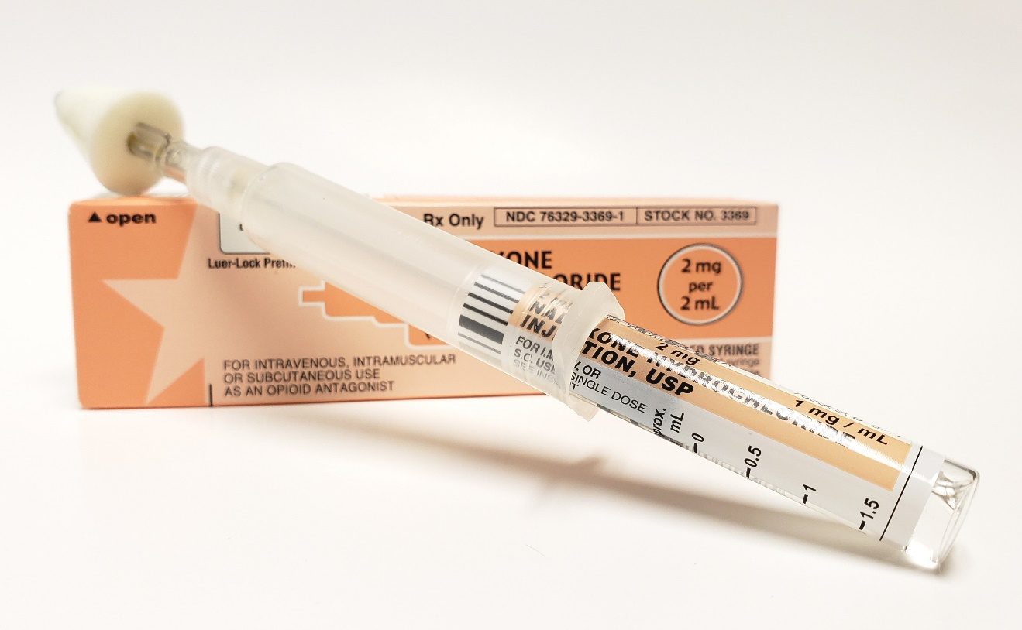
Why it Matters
Police transport an estimated 1 in 3 individuals in psychiatric crisis to hospital emergency rooms.
Thousands of people are alive today due to first responders administering naloxone.
Notes:
Police transport an estimated 1 in 3 individuals in psychiatric crisis to hospital emergency rooms.
Thousands of people are alive today due to first responders administering the overdose reversal medication naloxone.
Police and firefighters are often first on the scene, with many administering the medication to the same individual repeatedly, sometimes more than once in the same day. Frequent and repeated encounters with individuals struggling with mental health, substance use, and related behavioral health problems can produce compassion fatigue and perpetuate the misconceptions that individuals with mental illness are dangerous and/or that SUD is a moral failing.
These false beliefs stem partly from a lack of understanding about mental health and SUDs, and in part from the trauma these encounters produce—trauma that may transform into victim-blaming.

Slide 11



What’s the Impact
Even before first contact, bias and negative attitudes toward people with mental health and SUDs problems can affect the timeliness and quality of care.
Notes:
Even before first contact, bias and negative attitudes toward people with mental health and SUDs problems can affect the timeliness and quality of care.

Slide 12


First Responders
What's the Impact
Physical and emotional exhaustion from repeatedly dealing with people in distress over time can reduce a first responder’s ability to feel empathy and compassion.
Notes:
Physical and emotional exhaustion from repeatedly dealing with people in distress over time can reduce a first responder’s ability to feel empathy and compassion.
Many first responders who develop post-traumatic stress, mental health issues, or SUDs do not seek treatment due to fear of stigma.

Slide 13



First Responders
What Can We Do
Provide opportunities for first responders to interact with individuals with substance use and mental health problems outside of a crisis.
Train first responders in addiction and mental illness.
Notes:
Provide opportunities for first responders to interact with individuals with substance use and mental health problems outside of a crisis.
Train first responders in addiction science and overdose prevention and response. Introduce strategies for engaging and helping individuals under the influence of alcohol and drugs.
Work with leadership to cultivate an organizational culture that promotes tolerance and condemns discriminatory behavior.
Train responders in mindfulness techniques that can help reduce stress and compassion fatigue.

Slide 14


What Can We Do
Work with leadership to cultivate an organizational culture that promotes tolerance.
Train responders in mindfulness techniques that can help reduce stress and compassion fatigue.
Notes:
Work with leadership to cultivate an organizational culture that promotes tolerance and condemns discriminatory behavior.
Train responders in mindfulness techniques that can help reduce stress and compassion fatigue.

Slide 15

Questions

Slide 16

Follow Us On Social Media!
Facebook and Twitter:
  @GreatLakesATTC
  @GMhttc
  @GLPTTC
Photo: iStock
Notes:
If you would like to know more about what we are doing or information on upcoming events, please see our social media pages

